Slide 1
What Did We Learn from 70 Years of Using (and Researching) Instructional Film?
History of Ed Tech
EDC&I 510

Slide 2
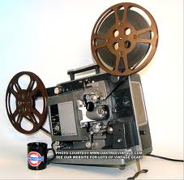
Early Years
Up to about 1950, film in school/education was a real novelty
Took special effort to use in class
Had to order films from distant distributors
Had to darken the room (and have a room that could be darkened)
Projectors were finicky

Slide 3
“Instructional Film?!”
No model for how to design, create
Initial use of clips from commercial films (Intolerance)
Early nitrate film stock made showing dangerous
Edison:
“Books will soon be obsolete in the schools…Scholars will soon be instructed through the eye. It is possible to touch every branch of human knowledge with the motion picture” (1913)

Slide 4
Typical Uses
Military training
WW I = first major use
“Rapid Mass Learning”
The medium was new; some doubted people could even learn anything from watching films

Slide 5
Propaganda
WW II
Used by all sides
Why We Fight series
First major research studies on affective results of film viewing
Some subtlety in the results – unconvinced viewers more swayed by even-handed presentation
Also: Public health, civil rights, etc.

Slide 6
Rise of the Instructional Film
Became a distinct “genre” in 1940s-50s
“Voice of God” narrator
Typically unimaginative presentation of factual material
Sappy “elevator music”
Short (≈10-20 min.; so could fit in typical class period, and leave discussion time)
Some basic efforts at building interest, motivation

Slide 7
Some Experimentation
Late 50s on, better directors get involved and more creative products appear
Capra (Our Mr. Sun, Hemo)
Why Man Creates
Better film production equipment, cameras, etc.

Slide 8
…and improved techniques
Slow motion, time lapse, etc.
Do these constitute a unique “symbol system” for film/video?

Slide 9
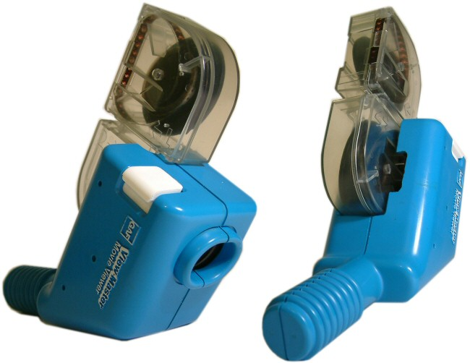
A Few Interesting Byways…
Super-8 Film Loops (1960s-70s)
Early effort towards “individualization”
Easier learner control
Instructional models with small-group use by students, etc.
Technically fairly clunky

Slide 10
Film to Video
Film gradually supplanted by video in 1970s
Easier equipment, media handling – classrooms became better equipped
Rise of VCR eliminated need for warehousing
Wider familiarity with both technology and moving images among teachers, students
“Parade of New Media” begins
Each new hardware system perceived as possible panacea for learning
Assumption that it was the device that would made the difference

Slide 11
So…
What did we study?
What did we learn?
What questions were left unanswered?

Slide 12
To Discuss
In Hoban & Van Ormer; May & Lumsdaine
How was learning conceptualized?
Variables: would we look at same issues now?
Are we still using any parts of that early research legacy?
Connections among Hoban/May, Salomon & Clark, Schmidt & Vandewater?
“Visual aesthetic” of film/video (effects, animation, etc.) – what has been most powerful for your own learning?

Slide 13
Leaving Aside…
Study Design Issues
Hawthorne & John Henry Effects
Experimental situation itself changes peoples’ behavior, may result in greater effort

Slide 14
What Mattered
Good Design
Outcomes specified; match to other parts of curriculum, learners’ prior knowledge
Activating Learners
Prior or embedded questions; cuing to key parts of film
Judicious Use of Production Values
Animations; time-lapse; close ups; POV

Slide 15
What Didn’t Matter So Much
Many Cinematic & Production Elements
Color (mostly); “finished” quality of script, etc.
“Realism”
Underspecified concept
Humor or Other “Motivational” Elements
“Motivating distractors”
Novelty Effects
Any novel medium is motivating for a while just because it’s new; but that effect fades rapidly

Slide 16
What Was Left Unanswered
Learner Control
Difficult to provide under existing physical and display limitations at the time
Medium-Specific Modeling
Salomon’s “zoom” studies, close-ups, time-lapse, etc.
Economics of Materials Development
Costs vis a vis texts; distribution and use; tie-ins to curricula, etc.

Slide 17
Questions that Faded with Time
“Mass” Instruction
Critical in military context (Cf. current “differentiated” approach)
Instructor Preparation
Instructors’ readiness to use a new technology, its fit with their thinking about instruction and learning (Rise of more media-savvy populace)
Physical Ease of Use
Availability of resources and conditions to use them in (Spread of better facilities)

Slide 18
Questions Still Key Today
Visualization effects
Animation, graphics, models, etc. – help establish mental models
Affective Engagement
(If you can hold attention for 15 sec. …)
Cf. Gaby Salomon “Television is "easy" and print is "tough“ … [AIME] (1984)

Slide 19
Questions for Next Week (10/19)
Holland chapter: connection between variables, approaches described there and those used in online or computer-based training today?
Mager: Do we still use “behavioral objectives” today? How/where? How different now?
Suppes: To what extent has his vision for computing in education been realized?

